Slide 1
Project Lifecycle
Project Name
Project Manager Name
Date

Slide 2
Agenda
Lifecycle
Planning Phase
Design Phase
Development Phase
Integration Phase
Deployment Phase
Post Deployment Phase
Project Direction

Slide 3
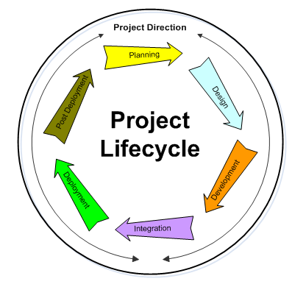
Project Lifecycle

Slide 4
Planning Phase
Project Concept
Concept Approval
Project Proposal
Proposal Approval
Project Charter
Project Approval

Slide 5
Planning Phase (cont/d)
The Project Plan
  Define “how” the project will be implemented
The Project Approach
  Define the processes to be used during the implementation of the project
Finalize Budget

Slide 6
Design Phase
Design the architecture
Design the product and the features
Create specifications and task lists
Finalize the project schedule

Slide 7
Development Phase
Build the product
Analyze and report project statistics
Status and project review meetings
Feature complete

Slide 8
Integration Phase
Integrate the features into the final “product”
Integration and end-to-end testing
Stabilization & optimization
Code complete

Slide 9
Deployment Phase
Finalize operations documents
Training
Deployment and acceptance
Project handoff

Slide 10
Post Deployment
Operations team take control of “product”
Lessons learned meeting
Project closure
Disband the project team
Celebrate success!

Slide 11
Project Direction
Not A project phase
The management and co-ordination of project activities
Ensuring applicable standards, processes and methodologies are followed
Managing the project team individuals
Project communication

